Slide 1
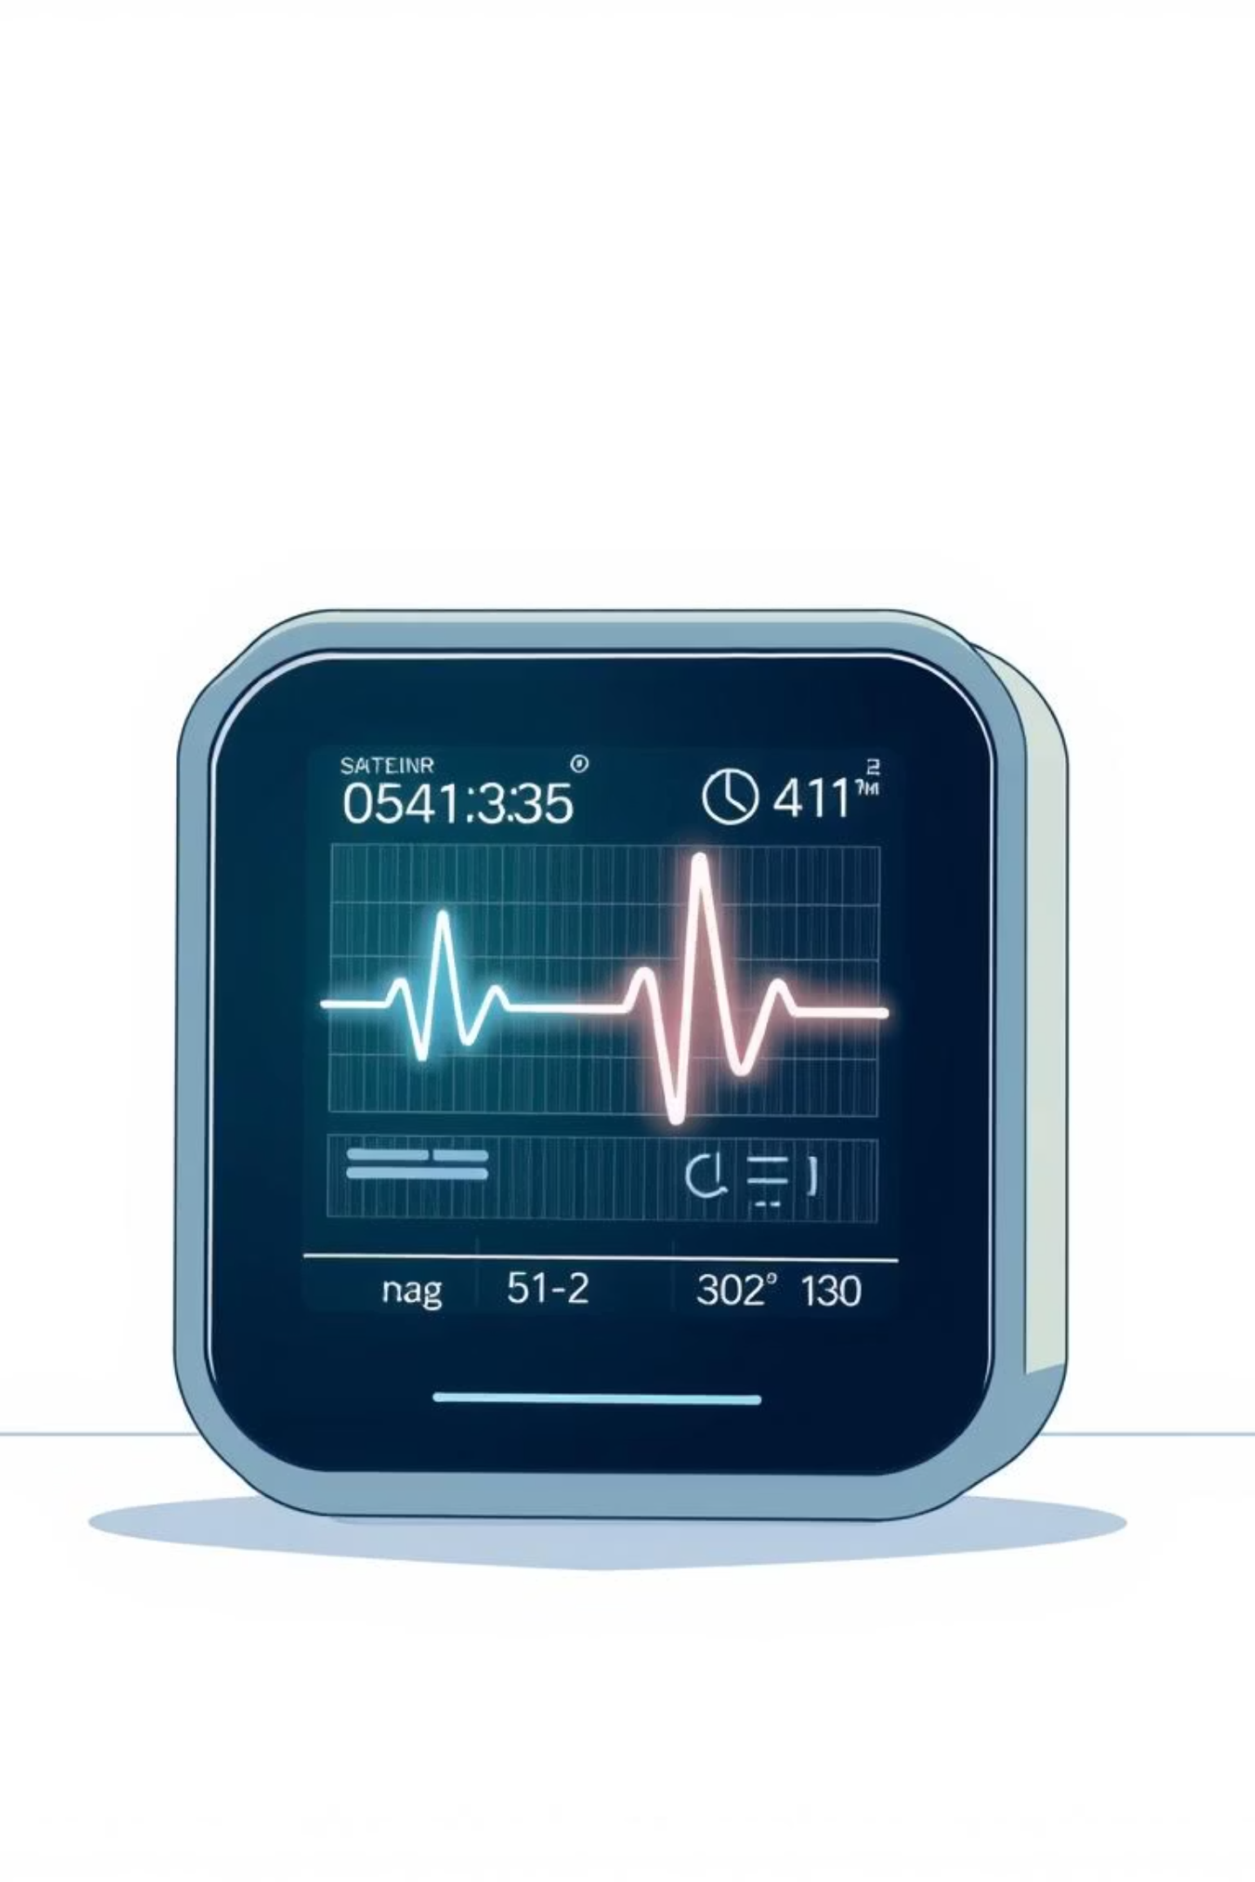
Predictive Pulse: Harnessing Machine Learning for Blood Pressure Analysis
Welcome to the future of healthcare monitoring. This presentation will introduce Predictive Pulse, a cutting-edge project utilizing machine learning to analyze and predict blood pressure fluctuations.

Slide 2
Agenda
1
Introduction to Predictive Pulse
Understanding the core concept and its potential.
2
Use Cases and Scenarios
Exploring practical applications in diverse settings.
3
Technical Workflow & Architecture
A deep dive into the machine learning pipeline.
4
Model Performance & Evaluation
Assessing the accuracy and reliability of our models.
5
Web Interface Demonstration
A visual tour of the user-friendly application.
6
Conclusion & Future Outlook
Key takeaways and next steps for Predictive Pulse.

Slide 3

What is Predictive Pulse?
Predictive Pulse is a pioneering project that leverages machine learning to analyze and forecast blood pressure changes. It integrates seamlessly with wearable devices and health monitoring systems, continuously collecting real-time physiological data such as heart rate, activity levels, and other vital biometrics.
This continuous stream of data is fed into advanced machine learning models hosted on IBM Cloud, enabling the system to analyze complex patterns and trends to predict blood pressure fluctuations before they occur.

Slide 4
Real-World Applications: Scenario Deep Dive
Hypertension Management
Fitness & Cardiovascular Health
Population Health Initiatives
For patients with hypertension, continuous monitoring can detect potential blood pressure spikes in real time, alerting both the patient and healthcare providers. This enables prompt intervention, such as medication adjustments, to prevent severe complications.
Fitness enthusiasts can utilize Predictive Pulse to track blood pressure trends over time, gaining personalized insights for optimizing workouts and lifestyle habits. This proactive approach helps maintain cardiovascular health and prevent potential issues.
Healthcare providers can remotely monitor at-risk individuals, identifying those prone to hypertension or sudden blood pressure changes. This facilitates targeted interventions, including lifestyle modifications, medication adherence reminders, or telehealth consultations.

Slide 5




The Predictive Pulse Machine Learning Pipeline
Our robust and transparent pipeline ensures accurate and reproducible machine learning outcomes. Each stage is meticulously designed for efficiency and reliability.
Data Preprocessing
Exploratory Data Analysis (EDA)
Transforms raw health data into a numerical, ML-ready format.
Gains insights, assesses distributions, and spots data issues.
Model Training
Model Evaluation
Fits multiple ML classifiers and serializes them for evaluation.
Consistently assesses model performance on a dedicated test set.

Slide 6

Data Preprocessing: From Raw to Ready
The initial phase focuses on converting raw, mixed-type tabular health data into a clean, fully numerical format suitable for machine learning models. This ensures data consistency and quality.
Import Dependencies: Loading essential libraries like pandas and scikit-learn.
Load Dataset: Reading raw data, including categorical and numerical variables, from CSV files.
Encode Categorical Columns: Applying OrdinalEncoder or OneHotEncoder to variables such as Age, Gender, Severity, and History.
Pipeline Construction: Utilizing ColumnTransformer to apply transformations specifically to relevant columns, creating a reusable Pipeline object.
Fit and Transform: Generating a fully numerical DataFrame and saving the preprocessor object for consistent future use.
Key Outputs: numerical_processed_patient_data.csv fitted_preprocessor.pkl

Slide 7

Model Training and Evaluation
Model Training Process
Model Evaluation Results (Test Set: 365 Samples)
We train five distinct classifiers on the same feature set, ensuring a diverse range of approaches to blood pressure prediction. Each model is trained independently and saved for consistent evaluation.
Random Forest and Decision Tree models achieved perfect accuracy, demonstrating exceptional predictive power for blood pressure analysis. Logistic Regression also performed strongly.
Logistic Regression
Random Forest
Decision Tree
Gaussian Naive Bayes
Multinomial Naive Bayes
Key Outputs: Individual .pkl files for each trained model, stored in the models/ directory.

Slide 8
Web Interface: User Experience
The Predictive Pulse web interface provides a seamless and intuitive user experience, allowing users to easily interact with the blood pressure analysis system.
Index Page (index.html)
Details Page (details.html)
This is the main landing page, designed for ease of use, where users can initiate the blood pressure analysis process with a simple click.
On this page, users input various patient details, providing the necessary physiological data for accurate predictions. The interface is structured for clear and efficient data entry.

Slide 9




Web Interface: Prediction Results
Prediction Results Page (prediction.html)
Real-time Feedback
After submitting their details, users are presented with a clear and comprehensive display of their blood pressure analysis results. This page is designed to provide actionable insights.
Instantaneous blood pressure predictions based on input data.
Trend Visualization
Graphical representation of predicted blood pressure trends.
Alerts and Notifications
Automated alerts for potential high or low blood pressure readings.
Actionable Recommendations
Personalized advice for lifestyle adjustments or medical consultation.

Slide 10
Conclusion & Next Steps
Key Takeaways
Future Directions
Innovative Solution: Predictive Pulse offers a proactive approach to blood pressure management using advanced ML.
Integration with more wearable devices for broader data input.
Development of mobile application for on-the-go monitoring.
Robust Performance: Our models demonstrate high accuracy, especially Random Forest and Decision Tree.
Expansion of predictive capabilities to other vital signs.
Partnerships with healthcare providers for wider adoption.
User-Friendly Interface: The web application ensures easy access and clear understanding of results for all users.
Thank you for your time. We believe Predictive Pulse can revolutionize personal and public health management.
Diverse Applications: From individual health tracking to population health initiatives, the potential is vast.

